Slide 1


DATA COMMUNICATION
CSE 225/233
WEEK-10, LESSON-1 & 2
ERROR DETECTION

Slide 2
Background
Networks must be able to transfer data from one device to another with acceptable accuracy. For most applications, a system must guarantee that the data received are identical to the data transmitted. Any time data are transmitted from one node to the next, they can become corrupted in passage. Many factors can alter one or more bits of a message. Some applications require a mechanism for detecting and correcting errors.
10.2

Slide 3
Types of Error
Whenever bits flow from one point to another, they are subject to unpredictable changes because of interference. This interference can change the shape of the signal.
There are two types of Error:
Single Bit Error
Burst Error
10.3

Slide 4
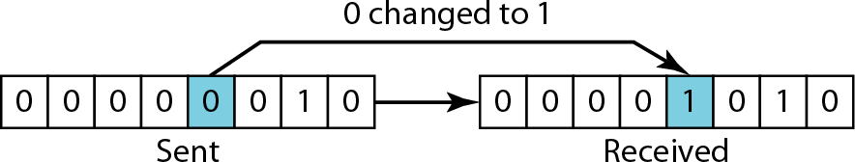
Single bit Error
The term single-bit error means that only 1 bit of a given data unit (such as a byte, character, or packet) is changed from 1 to 0 or from 0 to 1.
10.4

Slide 5
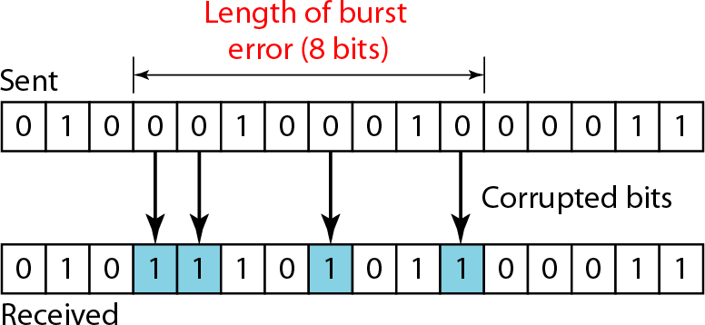
Burst Error
The term burst error means that 2 or more bits in the data unit have changed from 1 to 0 or from 0 to 1. Following figure shows the effect of a burst error on a data unit.
10.5

Slide 6
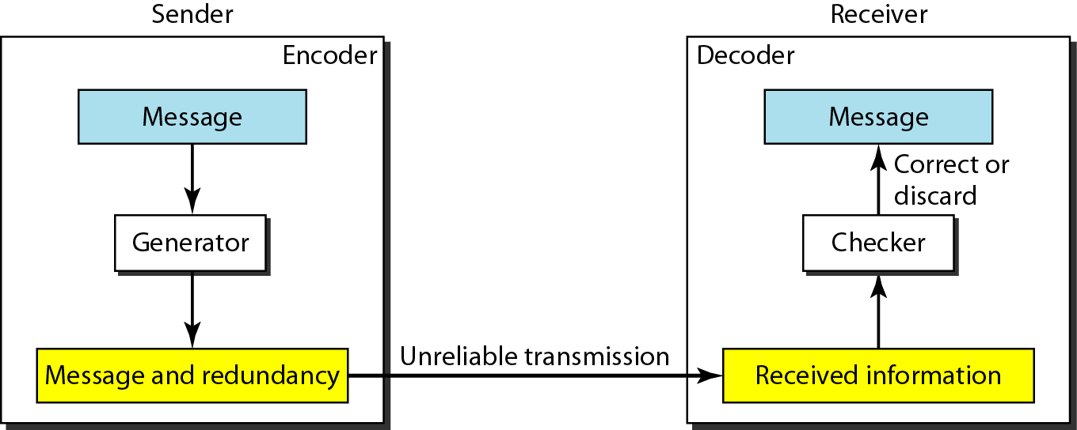
Redundancy
The central concept in detecting or correcting errors is redundancy. To be able to detect or correct errors, we need to send some extra bits with our data. These redundant bits are added by the sender and removed by the receiver. Their presence allows the receiver to detect or correct corrupted bits.
10.6

Slide 7
Detection versus Correction
The correction of error is more difficult than the detection. In error detection, we are only looking to see if any error has occurred. The answer is simple yes or no. We can not interested in the number of bits. A single bit error is the same for us as a burst error.
In error correction, we need to know exact number of bits that are corrupted and, more importantly, their location in the message. The number of error and the size of the message are important factor. If we need to correct a single error in an 8-bit data unit, we need to consider eight possible error location; if we need to two error in a data unit of the same size, we need to consider 28 (permutation 8 by 2) possibilities. You can imagine the receiver’s difficulty in finding 10 errors in a data unit is 1000 bits.
10.7

Slide 8
Block Coding
In Block Coding, we divide message into blocks, each of k bits, called datawords. We add r redundant bits to each block to make the length n=k+r. The resulting n-bit blocks are called codewords.
The number of possible codewords is larger than the number of possible datawords. This means that (2^{n} – 2^{k}) codewords are not used. We call these codewords invalid or illegal.
The trick in error detection is the existence of these invalid codes. If the receiver receives an invalid codeword, this indicates that the data was corrupted during the transmission.
10.8

Slide 9
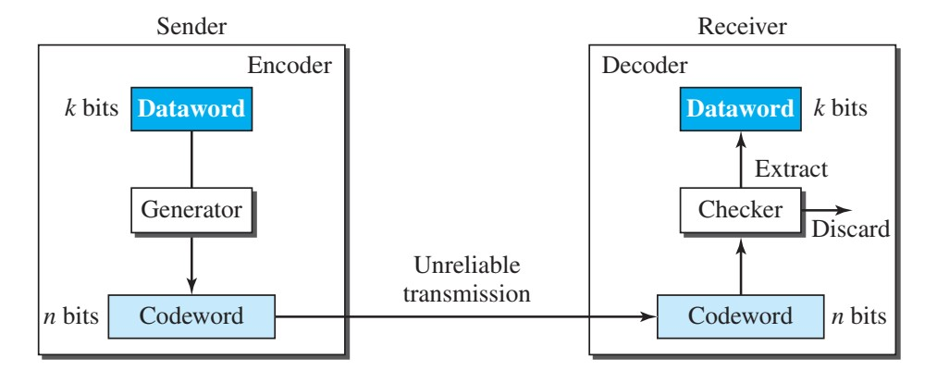
Error Detection
How can errors be detected by using block coding? If the following two conditions are met, the receiver can detect a change in the original codeword.
The receiver has (or can find) a list of valid codewords.
The original codeword has changed to an invalid one.
10.9

Slide 10
Error Detection
If the received codeword is the same as one of the valid codewords, the word is accepted; the corresponding dataword is extracted for use. If the received codeword is not valid, it is discarded. However, if the codeword is corrupted during transmission but the received word still matches a valid codeword, the error remain undetected.
10.10

Slide 11
Hamming Distance
One of the central concepts in coding for error control is the idea of the Hamming distance. The Hamming distance between two words (of the same size) is the number of differences between the corresponding bits. We show the Hamming distance between two words x and y as d(x, y).
For example, if the codeword 00000 is sent and 01101 is received, 3 bits are in error and the Hamming distance between the two is d(00000, 01101) = 3. In other words, if the Hamming distance between the sent and the received codeword is not zero, the codeword has been corrupted during transmission.
The Hamming distance can easily be found if we apply the XOR operation (⊕) on the two words and count the number of 1s in the result.
10.11

Slide 12
Example
Let us find the Hamming distance between two pairs of words.
1. The Hamming distance d(000, 011) is 2 because…
2. The Hamming distance d(10101, 11110) is 3 because..
10.12

Slide 13
Minimum Hamming Distance
The minimum Hamming distance is the smallest Hamming distance between all possible pairs in a set of words.
To guarantee the detection of up to s errors in all cases, the minimum Hamming distance in a block code must be
d_{min} = s+1

Slide 14
Example (1)
Find the minimum Hamming distance of the following coding scheme.
We first find all Hamming distances.
The d_{min} in this case is 2.

Slide 15
Example (2)
Find the minimum Hamming distance of the following coding scheme.
We first find all Hamming distances.
The d_{min} in this case is 3.

Slide 16
Example (3)
A code scheme has a Hamming distance dmin = 4. What is the error detection and correction capability of this scheme?
Solution:
This code guarantees the detection of up to three errors (d=s+1 or s = 3), but it can correct up to one error. In other words, if this code is used for error correction, part of its capability is wasted. Error correction codes need to have an odd minimum distance (3, 5, 7, . . . ).

Slide 17
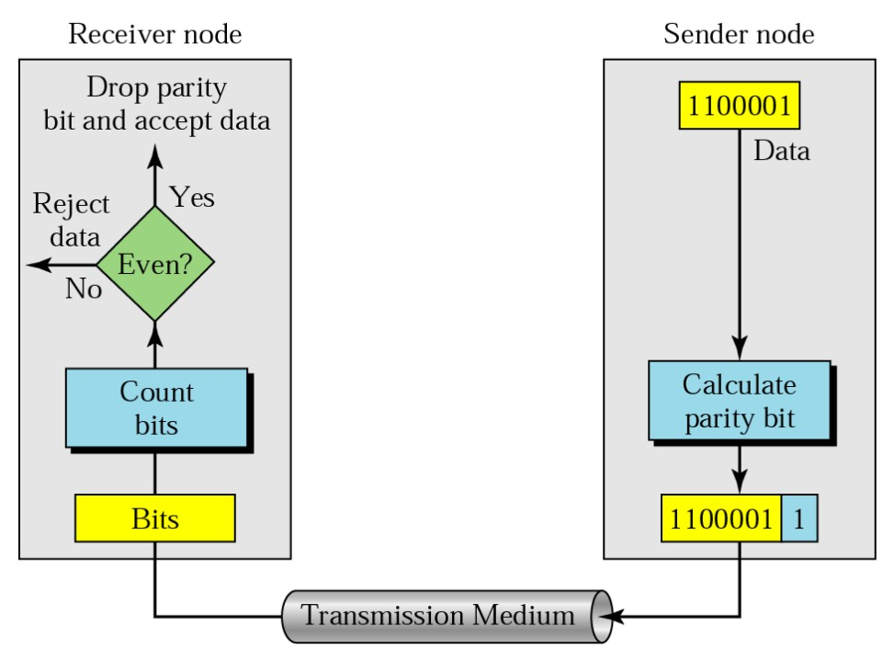
Simple Parity Check
Simple or Two Dimensional
In parity check, a parity bit is added to every data unit so that the total number of 1s is even (or odd for odd- parity).

Slide 18
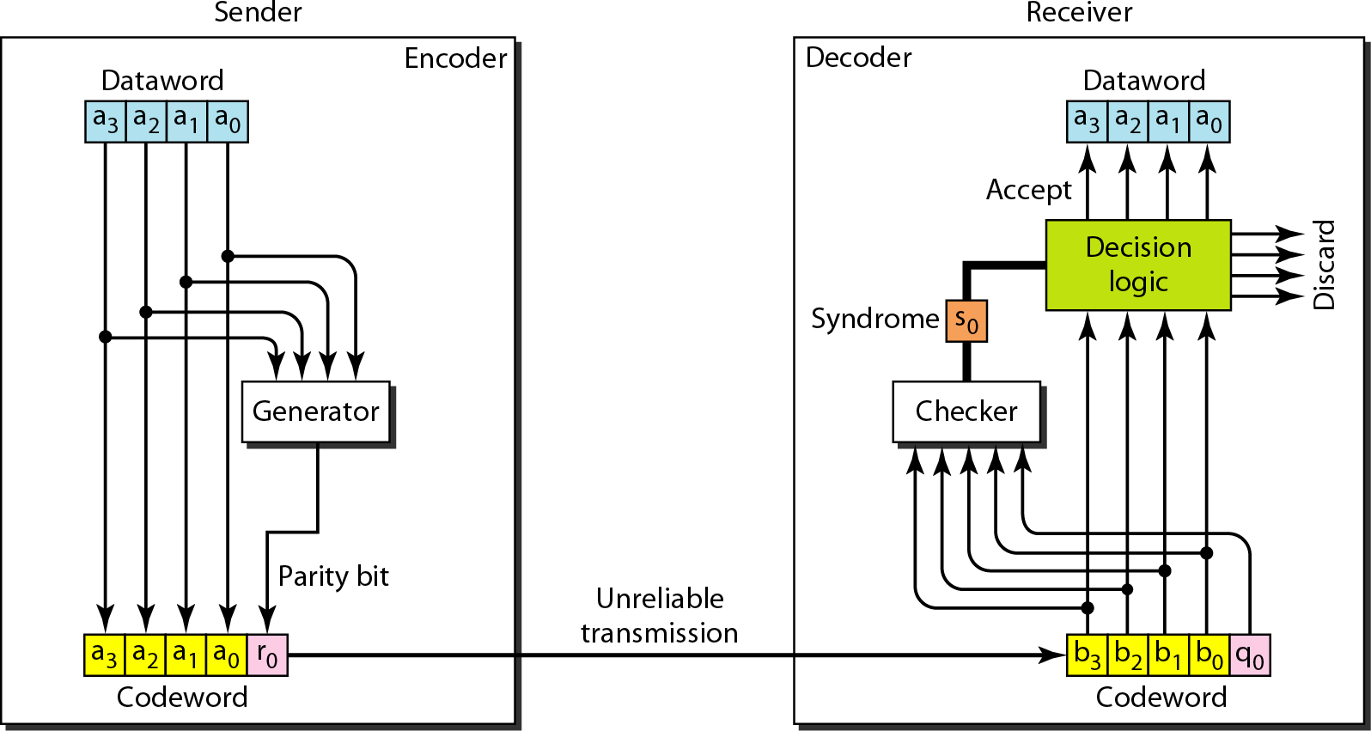
Encoder and Decoder for Simple Parity Check

Slide 19
Example (1)
Suppose the sender wants to send the word world. In ASCII the five characters are coded as
1110111 1101111 1110010 1101100 1100100
The following shows the actual bytes sent
11101110 11011110 11100100 11011000 11001001

Slide 20
Example (1) Contd.
Now suppose the word world in Example 1 is received by the receiver without being corrupted in transmission.
11101110 11011110 11100100 11011000 11001001
The receiver counts the 1s in each character and comes up with even numbers (6, 6, 4, 4, 4). The data are accepted.

Slide 21
Example (1) Contd.
Now suppose the word world in Example 1 (Slide 18) is corrupted during transmission.
11111110 11011110 11101100 11011000 11001001
The receiver counts the 1s in each character and comes up with even and odd numbers (7, 6, 5, 4, 4). The receiver knows that the data are corrupted, discards them, and asks for retransmission.

Slide 22
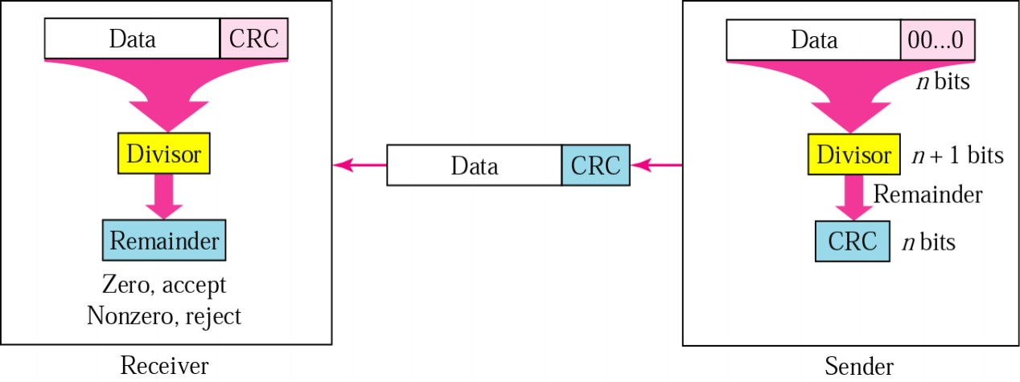
Cyclic Redundancy Check
Uses Binary division
Add CRC remainder to data.
Number of 0s appended is one less than the Divisor
Appending CRC to the end of the data must make resulting bit sequence divisible by the divisor

Slide 23
Cyclic Redundancy Check
A CRC code with C(7,4):
Dataword | Codeword | Dataword | Codeword
0000 | 0000000 | 1000 | 1000101
0001 | 0001011 | 1001 | 1001110
0010 | 0010110 | 1010 | 1010011
0011 | 0011101 | 1011 | 1011000
0100 | 0100111 | 1100 | 1100010
0101 | 0101100 | 1101 | 1101001
0110 | 0110001 | 1110 | 1110100
0111 | 0111010 | 1111 | 1111111

Slide 24
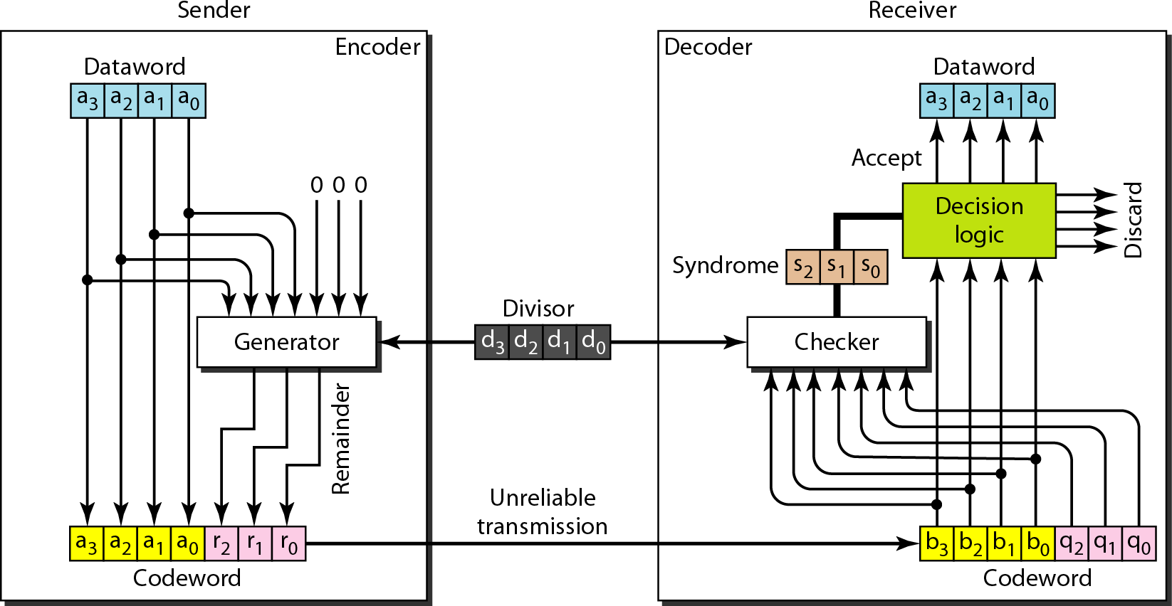
CRC Encoder and Decoder

Slide 25
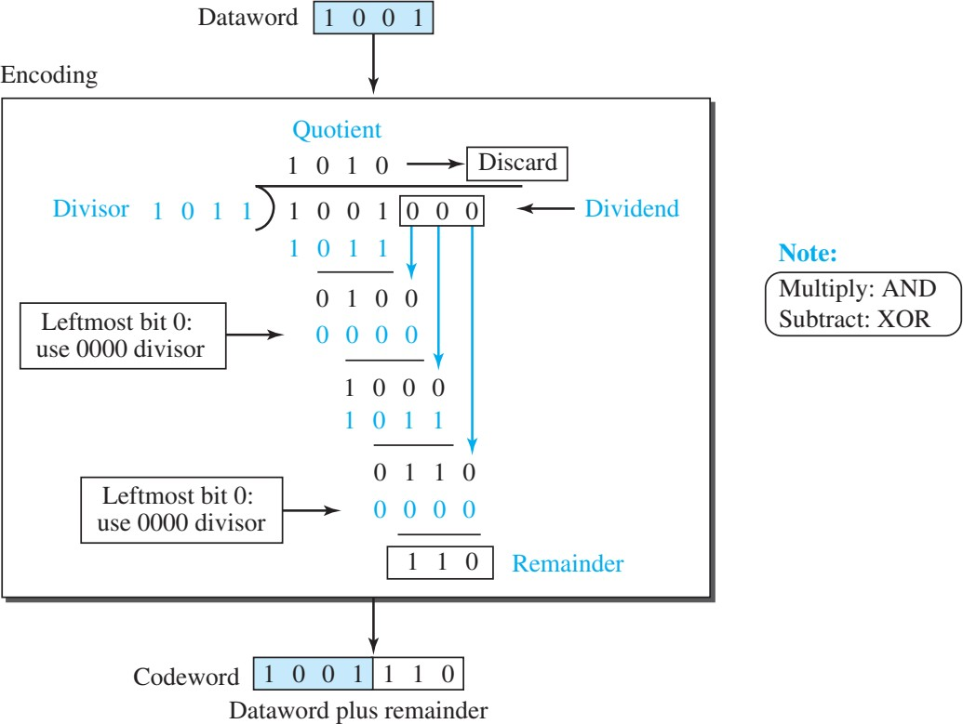
Division in CRC Encoder

Slide 26
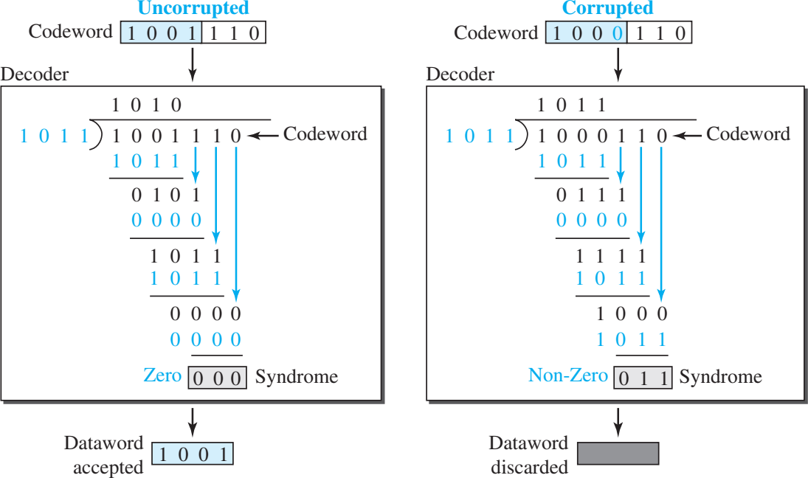
Division in CRC Encoder for Two case

Slide 27


